Slide 1

Insurance Analytics Project
P738

Slide 2
TEAM MEMBERS
Aditya Rajendra Varpe
Aparna Viswanath
Barinika Bhanu Sree
Harshita Pramodkumar Mishra
Pamela Michael
Priyanka Pawan Valanjuwani

Slide 3
CONTENTS
Introduction
Problem statement
KPIs
Dashboards
Challenges
Conclusion

Slide 4
INTRODUCTION
Insurance analytics is the application of data analysis techniques to transform vast amounts of insurance data into actionable insights. By analyzing historical data and identifying patterns, it helps insurers assess risks, optimize pricing strategies, and improve underwriting accuracy.
It also enables companies to enhance customer satisfaction by providing personalized services and efficient solutions.

Slide 5
PROBLEM STATEMENT
Insurance companies face challenges in effectively analyzing large volumes of data related to claims, policies, customer behavior, and market trends.
Manual analysis often leads to inefficiencies, delayed decision-making, and missed opportunities for optimizing operations and improving customer satisfaction.
The project aims to develop interactive dashboards that provide real-time insights into key metrics such as claims trends enabling data-driven decisions and streamlined processes.

Slide 6
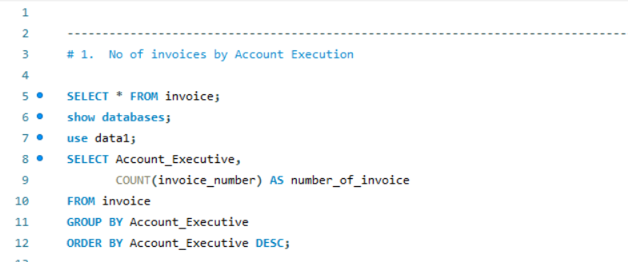
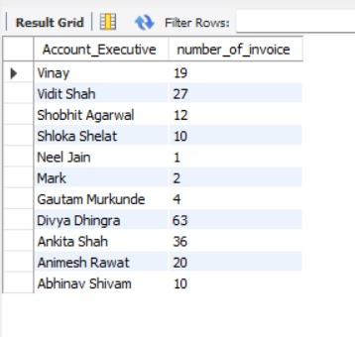
KPIs
1. No of Invoices by Account Execution

Slide 7
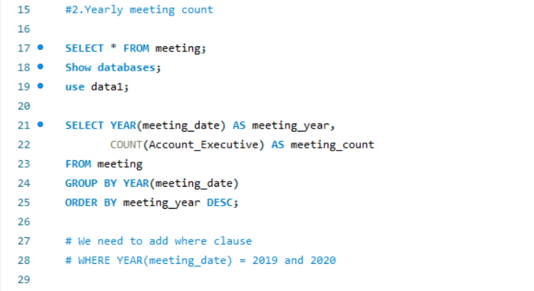
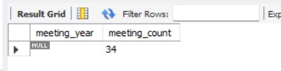
2. Yearly Meeting Count

Slide 8
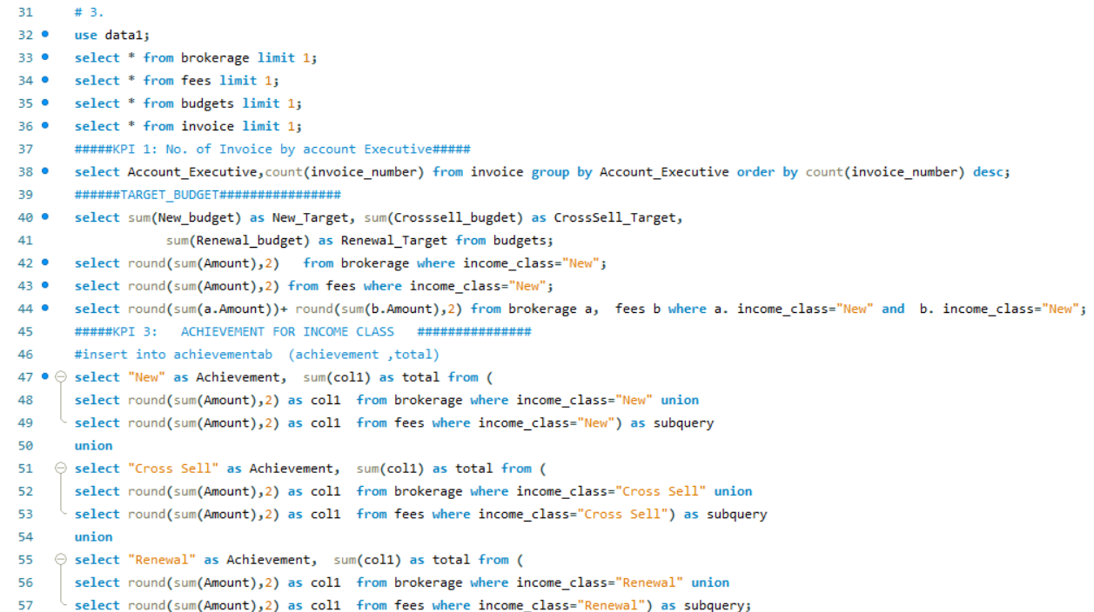
3.

Slide 9
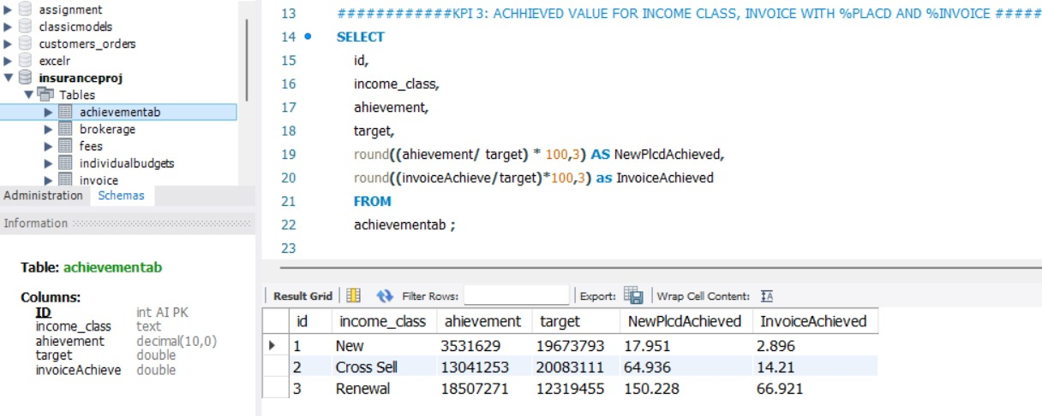

Slide 10
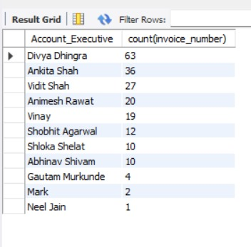
3.1 Cross Sell- Target, Achieve, New

Slide 11
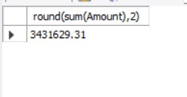
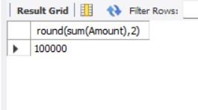
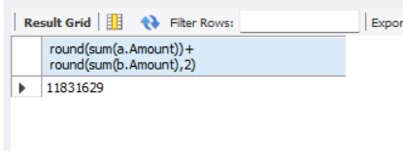
3.2 New- Target, Achieve, New

Slide 12
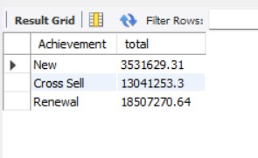
3.3 Renewal- Target, Achieve, New

Slide 13
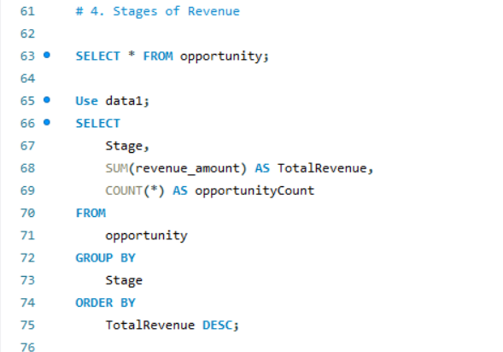
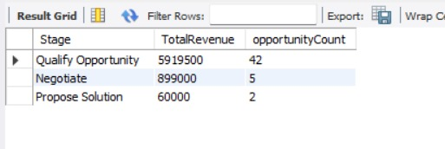
4. Stage Funnel by Revenue

Slide 14
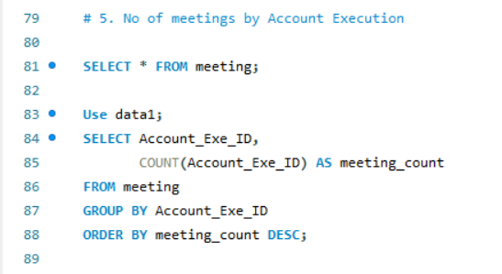
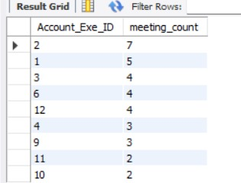
5. No of Meeting by Account Execution

Slide 15
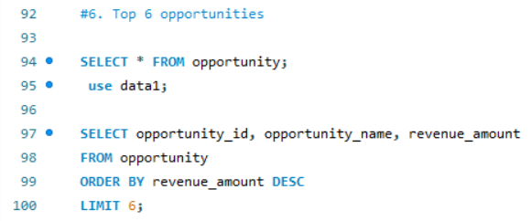
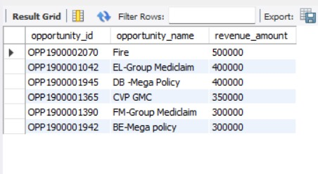
6. Top Open Opportunity

Slide 16
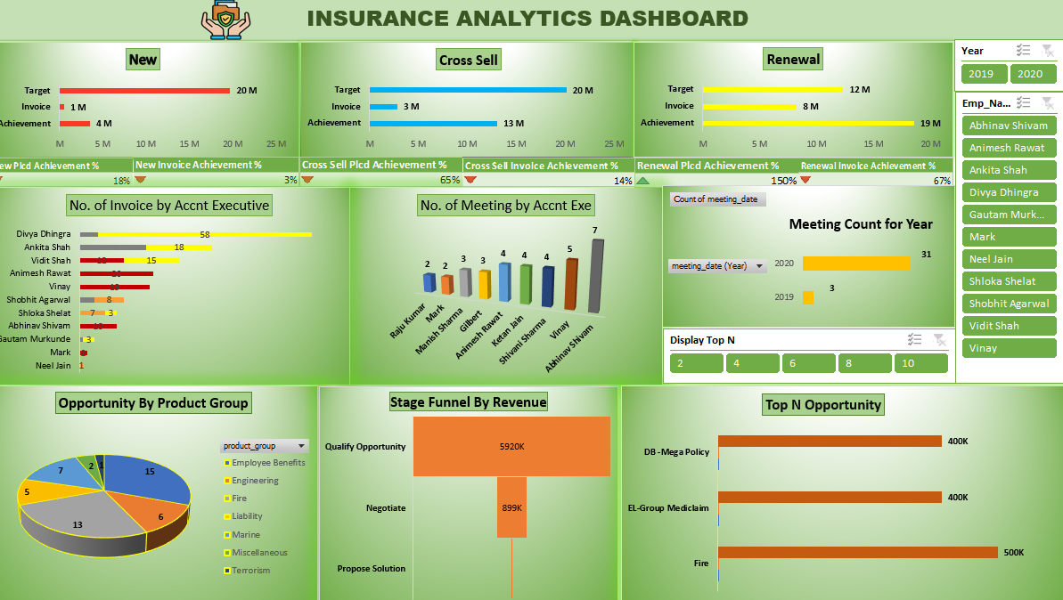
Excel Dashboard

Slide 17
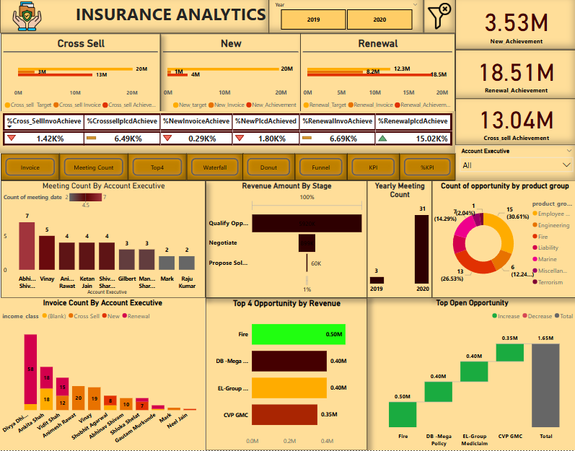
PowerBI Dashboard

Slide 18
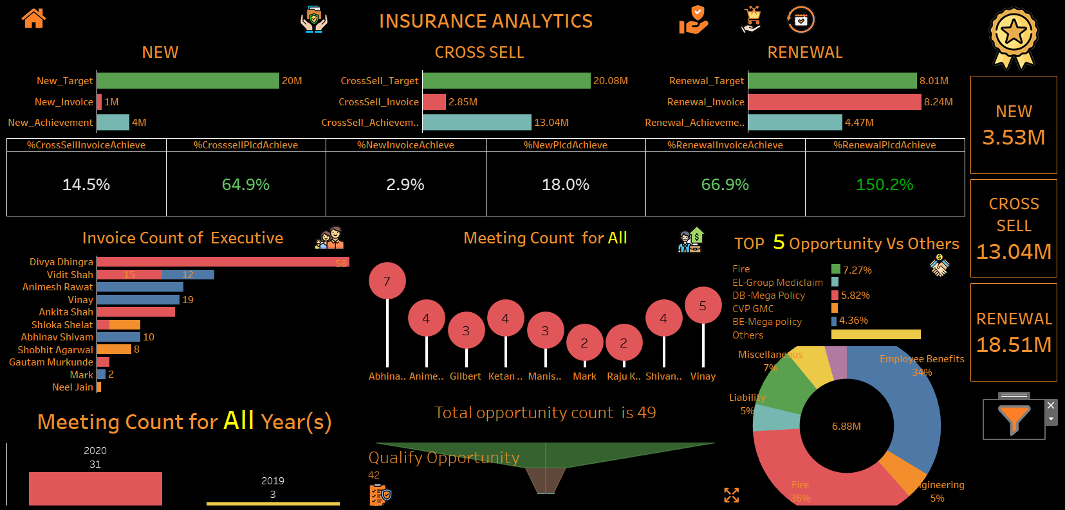
Tableau Dashboard

Slide 19
CHALLENGES
Data Integration and Cleaning:
We used ETL (Extract, Transform, Load) processes and tools like Power Query to clean, format, and standardize the data for analysis.
Complex Data Visualizations:
We used interactive visuals and selected the most relevant KPIs to make dashboards intuitive and actionable.
Scalability of Dashboards:
We designed the dashboards with scalable architecture, optimized queries, and Power BI for performance and flexibility.

Slide 20
CONCLUSION
Project shows how interactive dashboards can turn raw data into useful insights.
The dashboards make it easier to make quick, informed decisions, assess risks, and improve efficiency by displaying important information like claims trends, policy performance, and customer behavior.
Proves how analytics tools can help streamline processes, cut costs, and provide better services in the insurance industry.

Slide 21
THANK YOU!!

